Slide 1
Using Brain Science to Improve
Study Skills
Chapter 6

Slide 2
Brain Science and Practical Learning Strategies

Slide 3
New discoveries are disproving traditional theories:
Learning styles
Left or right brain theories

Slide 4
What’s New?

Slide 5
Multisensory Integration
Learning is increased by using and integrating all the senses, not just preferred ones.

Slide 6
All the senses work together as a team to store information in long-term memory. What senses can you use to remember?

Slide 7
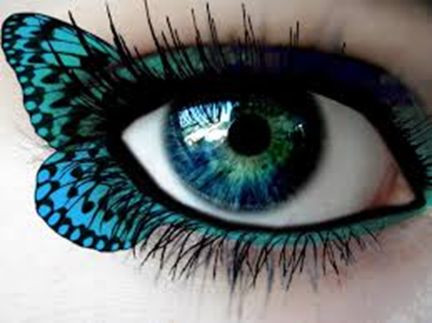
Visual: learning through reading, observing, or seeing things.
Most scientists agree that vision is the best tool to learn anything.

Slide 8
Visual Examples
Make a visual image or video of what you are learning.
Use color to highlight important points.
Use mind maps to summarize information.
Pay attention to pictures, graphs, charts.
Use YouTube to explain difficult concepts.

Slide 9

Auditory: learning through listening and talking
Use auditory strategies to reinforce visual learning.

Slide 10
Auditory Examples
As you are reading, ask questions or say out loud what you think is important.
Rehearse or say information verbally.
Discuss what you are learning with others.

Slide 11

Kinesthetic Learning
Reinforce your learning by using a “hands on” approach.

Slide 12

Tactile Examples
Writing is one of the best tactile learning strategies.
Take notes, write a journal, or make an outline.
Use real objects to help you learn. For example, in learning fractions, cut an apple in half.

Slide 13

Kinesthetic: learning through movement
You don’t forget how to ride a bike, right?

Slide 14
Kinesthetic Examples
Move while studying. Review the important points while on your exercise bike.
Study in different locations.
Use a study group to teach someone else.

Slide 15
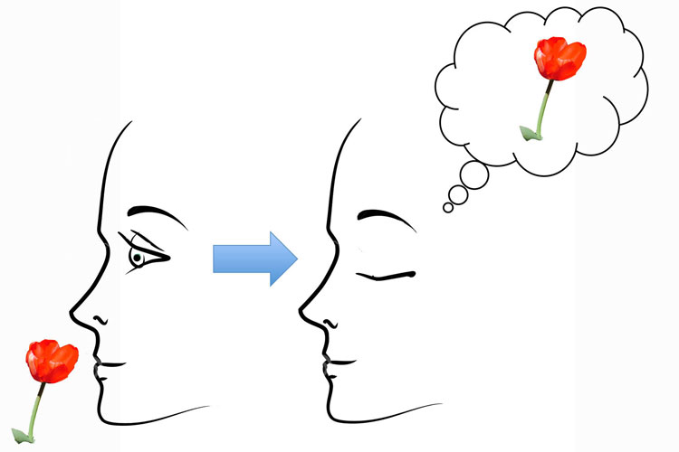
Olfactory: learning by smell
Smell is strongly associated with memory and learning because it is connected to emotions.
Can you remember the smell of fresh baked cookies?
Are the commercials correct? Does your body spray attract the opposite sex?

Slide 16
Olfactory Examples
When creating that visual picture or video, include the sense of smell.
Study with a scented candle.
Can you think of creative ways to use smell?

Slide 17
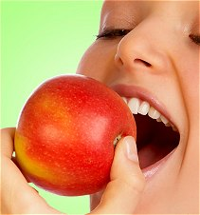
Gustatory: learning through taste
The sense of taste stimulates the reward center of the brain which regulates motivation and learning.

Slide 18
Gustatory Examples
Chew gum while studying
Occasionally enjoy your favorite piece of candy while learning something difficult.
Caution: Use this technique in moderation so you don’t gain weight.

Slide 19
Use all your senses to remember.
For example, when learning Spanish, motivate yourself to learn by watching travel videos, listen to the words and say them out loud, make a visual picture of the words you are trying to remember, imagine the smell of Mexican food, eat some salsa and chips, and if possible, travel to a Spanish speaking country to practice the language. Review vocabulary while on your exercise bike. Study in different locations.

Slide 20

Read to Remember

Slide 21
SQ4R
A shortcut to college reading

Slide 22
Read once
Instead of Re-reading.
Recite for memory improvement.

Slide 23
Step 1
Survey
Question
FAST

Slide 24
Why?
Beginning of speed reading
Improves comprehension

Slide 25
How?
Quickly look over the chapter.
Turn the subtitles into questions.

Slide 26
Survey
See the big picture.
Ease into studying.
Warm up.
Create a basic background.
Get started.

Slide 27
Question
Read to find answers
Improves reading comprehension
Forces you to concentrate
??

Slide 28
Keeps you awake

Slide 29

Become an Active Reader

Slide 30
Exercise: Surveying and Questioning a Chapter

Slide 31
Step 2
Read
Recite
SLOW
FAST

Slide 32
This step is most important for
Memory

Slide 33
How?
Read to identify
the topic sentence
or main idea.

Slide 34
Underline or highlight the idea if it is important.

Slide 35


When reading is tough
Read it again.
Look up new words.
Read it aloud.
Ask the instructor.
Stand up and read.
Use tutoring.
Pretend you understand.
Take a break and come back later.

Slide 36
Use 3X5 cards to learn new words.
3x5 card

Slide 37
Recite
Most powerful memory technique
Converts information from short term to long term memory
Keeps you alert
FAST

Slide 38
Step 3
Review
Reflect
FAST

Slide 39
Why?
Reinforces memory

Slide 40

When?
Most of the forgetting occurs
in the first 20 minutes.

Slide 41
How to Review
After each main section, review the main points.
At the end of the chapter, quickly review the main points one more time.
Do your review quickly.

Slide 42

Reflection is the creative step.

Slide 43

Reflection
How can I use this?
What is important?
How does it relate?
How can I use it
in my career?
Is it true?

Slide 44
A step beyond memorization is
Wisdom
REFLECT

Slide 45
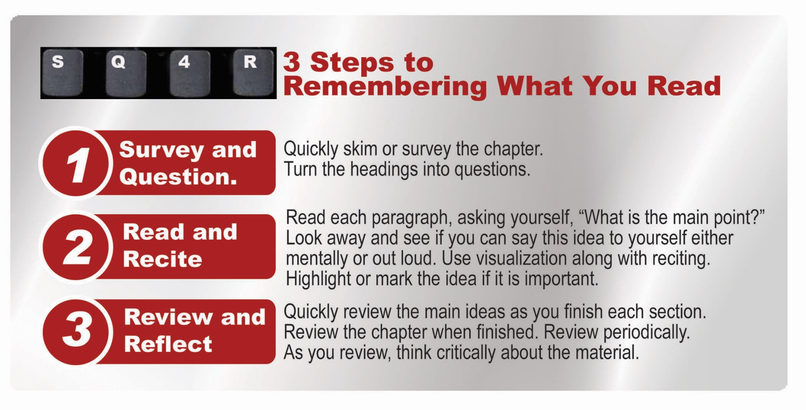
Sum:SQ4R

Slide 46

Succeeding in Math

Slide 47
Why study math?
Math is the most failed subject in college.
It is required for graduation.
It is needed for entry into high paying scientific, technical and business occupations.

Slide 48
Reading a Math Text
Skim the text before class to become familiar with the topics. Find out what you need to learn.
As you are reading, make flash cards of the key definitions and formulas.
It is not enough to read and understand. Add practice to your study system.
Focus on understanding rather than memorization.

Slide 49

Tips for Math Success

Slide 50

Think Positively
“I can learn to be successful in math.”

Slide 51
Internal Locus of Control
Take responsibility for your own success.
Get help when you need it.

Slide 52

Increase Motivation
Review the motivation tips in the first chapter and use them to study math.

Slide 53
Prepare Adequately
Did you know that in order to be successful, it takes about 10 hours a week to study for your math course?
Make a study schedule.

Slide 54

My goal: Earn an A or B
If you do not earn an A or B in your math course, you will probably not succeed in the next level.

Slide 55
Math Is a Priority
Use your prime time when you are most alert to study math.

Slide 56
Review
To minimize forgetting, review what you have learned in your math class as soon as possible after the class

Slide 57

Use a Study Group
Use the study group to practice problems that might be on the exam.

Slide 58

Ask Questions in Class
Ask questions as soon as you don’t understand anything.
Other students may have the same question and be thankful you asked it.

Slide 59
Use Multi-Sensory Techniques
Use all your senses to study math.
Read important concepts out loud.
Use flash cards.
Watch YouTube videos on difficult concepts.
Use different colors of ink to take notes.
Take pictures of problems on the board.
Use math manipulatives.
Use Facebook to discuss math problems.

Slide 60

Online Reading Strategies
What is your purpose for reading?
For college material:
Scan first.
Look for key points.
Make note of the important points.
Review.

Slide 61

What to do if the reading goes in one ear and out the other?
Tell yourself you can do it!
Try visualization.
Look for personal meaning.
Scan for important points.
Talk to the text as you read it.

Slide 62

Tips for Online Learning

Slide 63
Advantages and Disadvantages
Advantages
No commute
Save money
Learn at your own pace
Convenient
Disadvantages
Less interaction between students and the instructor
Avoiding procrastination with a flexible schedule

Slide 64
Balance Freedom and Responsibility
Freedom
Responsibility
Flexibility
Convenience
Procrastination is the leading cause of lack of success in online courses

Slide 65
Tips for Success
Establish a personal schedule.
Minimize distractions such as cell phones and social media.
Read the syllabus to understand how the course works and when assignments are due.
Distributed practice and frequent review work best.

Slide 66
Review Tools for Online Courses
Take notes and review them.
Read the material out loud?
Is there an option for highlighting?
Read a small amount of material at a time.
For detailed information, make flash cards and review them.

Slide 67
How are online courses different?
They require more writing.
Creative projects are more likely than traditional objective assessments.

Slide 68
Guidelines for Marking a Text

Slide 69
A Mind Map for Marking a Text
“THE ESSENCE OF
GENIUS IS KNOWING
WHAT TO OVERLOOK”
BE SELECTIVE
20%

Slide 70
Marking
WHY?
MEMORY
SAVE TIME
“THE ESSENCE OF
GENIUS IS KNOWING
WHAT TO OVERLOOK”
BE SELECTIVE
20 %

Slide 71
Marking
WHY?
“THE ESSENCE OF
GENIUS IS KNOWING
WHAT TO OVERLOOK”
MEMORY
SAVE TIME
BE SELECTIVE
20 %
GUIDELINES
READ FIRST
ORGANIZE
NOTES IN MARGIN
BRIEF
FAST AND NEAT

Slide 72
Marking
WHY?
MEMORY
SAVE TIME
“THE ESSENCE OF
GENIUS IS KNOWING
WHAT TO OVERLOOK”
SYMBOLS
BE SELECTIVE
GUIDELINES
20 %
1 2 3
READ FIRST
*
* *
ORGANIZE
NOTES IN MARGIN
BRIEF
FAST AND NEAT

Slide 73
Marking
DOUBLE SYSTEM
1. UNDERLINE IN PENCIL
2. HIGHLIGHT AS PART OF
REVIEW
WHY?
MEMORY
SAVE TIME
“THE ESSENCE OF
GENIUS IS KNOWING
WHAT TO OVERLOOK”
SYMBOLS
BE SELECTIVE
20 %
GUIDELINES
1 2 3
READ FIRST
*
* *
ORGANIZE
NOTES IN MARGIN
BRIEF
FAST AND NEAT

Slide 74
More Ideas on Text Marking
Point out definitions by writing DEF in the margin. Circle the word being defined.
Point out examples by writing EX in the margin
Write SUM in the margin to point out useful summaries to reread.

Slide 75
Group Activity:
Make a Mind Map
Use How Does the Memory Work?

Slide 76
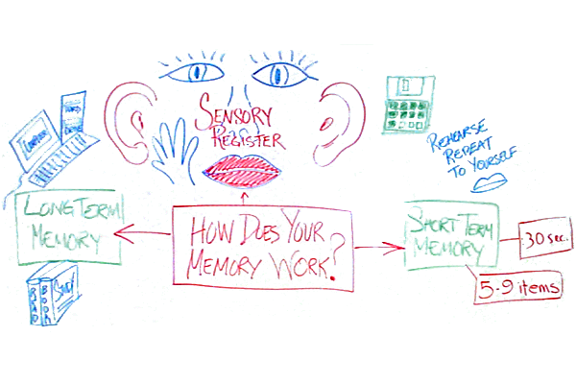
An Example of a Mind Map

Slide 77
Patterns of Organization are Keys to Understanding the Main Idea:
Listing Pattern
Sequence Pattern
Definition Pattern
Comparison/Contrast Pattern
Cause/Effect Pattern

Slide 78

Understanding the main ideas=
Success on tests

Slide 79
The Listing Pattern Presents a List of Items
Your task as a reader is to identify all the items listed.
Watch for clues such as numbers or letters.
First
Second
Third
1, 2, 3
A B C D

Slide 80
Sequence Pattern
Presents a list of items in a specific order. The order is important.
As a reader, identify and mark all items in the series and note their order.
Again clues are numbers or letters.
Notice words such as then, next, finally

Slide 81
Definition Pattern
Presents an explanation of a term
As the reader, understand all parts of the definition
Watch for words such as: is, is defined, this term means, is known as, refers to

Slide 82
Comparison/Contrast Pattern
Presents similarities or differences
As a reader, recognize these similarities or differences
For comparisons, notice these words: similarly, likewise, also
For differences, notice these words: however, in contrast, on the other hand, nevertheless

Slide 83
Cause/Effect Pattern
Presents the reasons things happen (causes) and their results (effects)
As a reader understand the cause and effect
For cause notice these words: causes, produces, leads to, results in
For effect notice these words: results from, was caused by, due to, consequently, therefore

Slide 84

Keys to Success:
Create Your Success
Your decisions and behavior create the future.

Slide 85

Appreciating Island Cultures: Tiare Apetahi, a story from Raiatea
Read and discuss in class.

Slide 86
Exercises:
Check Your Textbook Reading skills
Scenarios

